Slide 1
Phase II Trial Design In Oncology Drug Development
Wendy R. Parulekar MD FRCP
Senior Investigator
Canadian Cancer Trials Group
Queen’s University

Slide 2
Disclosures
Pfizer
Celgene
Hecht Foundation
CBCF
CIHR
AstraZeneca
TerSera
Roche
Novartis/AAA

Slide 3
Learning Objectives
To define the role of a phase II trial in oncology drug development
To describe the objectives and the statistical parameters that provide the framework of a phase II trial design

Slide 4
Phase II Trial
The phase II trial has a pivotal role in drug development since the major decision to proceed with further testing is usually based on phase II trial results.

Slide 5
Phase II Trial Screens for Efficacy
Primary goal
Identify and characterize the preliminary clinical efficacy of a new agent/ combination of agents/ schedule of administration
Secondary goals
Characterize adverse event profile
Understand mechanism of action
Further define target population for administration of agent

Slide 6
Phase II Trial Designs
Multiple designs available
Variations based on
    specific stage of development of the therapeutic intervention
    how the results will inform continued therapeutic development

Slide 7
Phase II Trial Designs
Defining characteristics
    Endpoints: primary and secondary
    Single or two stage design
    Single arm or multiple arm design
    Statistical considerations: Type I (α) and II (β) error rates; measures of anticancer activity (e.g. response rates, hazard ratio….)

Slide 8
A Sampling of Phase II Trial Designs

Slide 9
Standard Single Arm Phase II Trial
Comparison is “fixed” constant – historical control
Binary endpoint (e.g. clinical response vs. no response)
Requirements
    α = Type I error
    β = Type II error
    H0: null response rate – not of interest
    HA: target response rate – of interest
Based on design parameters sample size= N

Slide 10
HN.10
A Phase II Single Arm Trial of Elective Volume Adjusted De-Escalation Radiotherapy (EVADER) in Patients with Low-risk HPV-related Oropharyngeal Squamous Cell Carcinoma

Slide 11
Rationale
  Low risk, HPV associated oropharyngeal squamous cell carcinoma
  Curatively treated with radiotherapy
  Long term treatment related morbidity is common
    eg. swallowing and salivary gland function
  Volume de escalation of radiotherapy fields may lessen burden of toxicity without a compromise in disease control

Slide 12
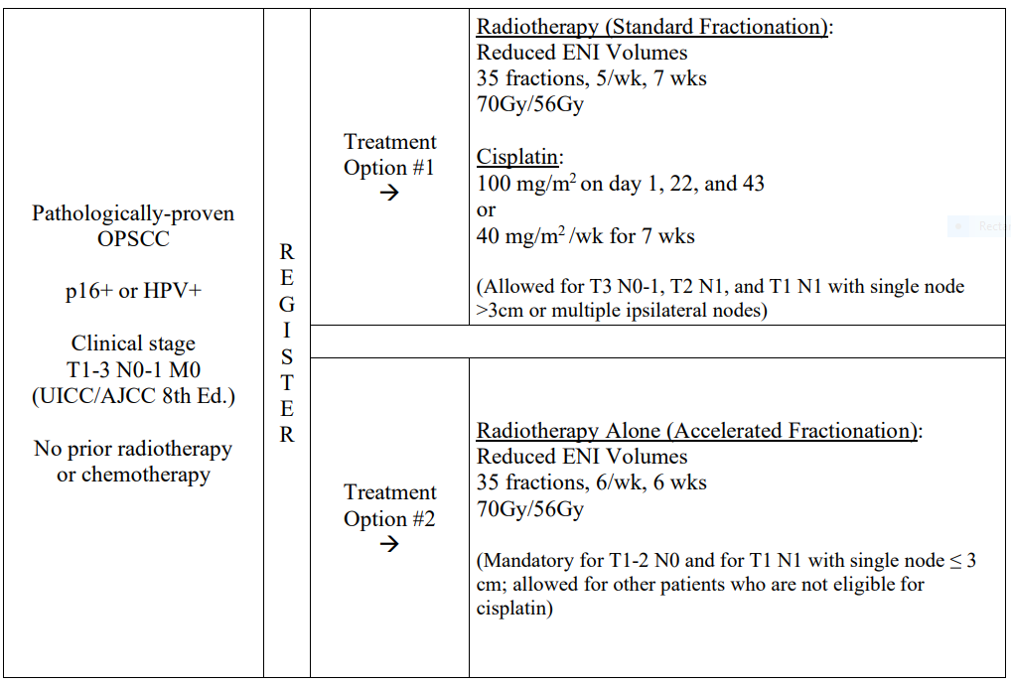
HN.10

Slide 13
HN.10 Endpoints
Primary
Two year event free survival
  Secondary
  Overall survival
  Disease control (local, regional, local-regional, out-of-field regional)
  Distant metastasis free survival
  Early and late toxicities of treatment
  Subjective swallowing functions
  Quality of life (QOL)
  Utilization of healthcare resources, work productivity
  Prognostic biomarkers

Slide 14
HN.10 Statistical Parameters
  2 year EFS: H0 < 85% HA =91%
  Type 1 (α) error = 0.10; power (1- β) = 80%
  Sample size 100; 304.7 person-years of follow-up required for the final analysis
  Current Status: accrual complete, follow-up ongoing

Slide 15
Can we improve the efficiency of the single stage phase II trial design?

Slide 16
Two stage trial designs will limit exposure to inactive treatment strategies

Slide 17
Two-Stage Trial Designs
Gehan two-stage design (1961)
    Allows early termination for inefficacy
Fleming two-stage design (1982)
    Allows early termination due to efficacy or inefficacy
Simon two stage design (1989)
    Preserves the type I (α) and II (Β) error rates and allows an early look; minimizes the expected sample size for an inactive treatment strategy

Slide 18
IND.182
Buckstein et al., Leuk LymphoMA 2011
Sunitinib in relapsed or refractory diffuse large B-cell lymphoma: a
clinical and pharmacodynamic phase II multicenter study of the NCIC Clinical Trials Group

Slide 19
Rationale
Relapsed or refractory diffuse large B cell lymphoma
  25-30% cured with salvage chemotherapy and bone marrow transplant
  VEGF pathway is important – implicated in progression
Sunitinib is an orally bioavailable inhibitor affecting receptor tyrosine kinases involved in tumor proliferation and angiogenesis (VEGFR-1, -2, -3, and PDGFR-a and –b)

Slide 20
IND.182
Relapsed/ refractory or transformed B cell lymphoma
R E
G
I
S
T
E
R
Sunitinib
37.5 mg po daily, q 4 weeks
Response

Slide 21
IND.182 Endpoints
Primary
  Objective response using standard criteria for non-Hodgkin lymphoma
Secondary
  Toxicity
  Progression Free Survival (PFS)
  Anti-angiogenic activity: circulating and apoptotic endothelial cells and precursors

Slide 22
IND.182
Statistical Parameters
  H0 =5% HA =20%
  Type 1 (α) error = 0.12 ; power (1- β) = 89%
  Two stage:
    Ist stage: enroll 15 patients – continue if at least one response
    2nd stage: additional 10 patients
  Sunitinib worthy of further study if at least 3 responses in 25 patients

Slide 23
IND.182 Results
  Response Rate
  First stage: 17 eligible patients, 15 evaluable for response
    No responses seen – study stopped
No convincing pharmacodynamic evidence of antiangiogenic activity (CEC and CEP biomarker analysis)

Slide 24
IND.182 Conclusions
  Sunitinib
  Inactive in patients with relapsed or refractory diffuse large B cell lymphomas

Slide 25
Single Arm Phase II Trial Design Limitations
Challenging due to choice of historic control for estimation of H0
Biases in patient selection, earlier detection of disease states, differences in disease outcome assessment, improvements in supportive care may contribute to estimate of activity - independent of drug effect

Slide 26
Can we refine the design of the phase II trial?

Slide 27
Randomized phase II trial designs may address some of the limitations of the single arm trial: confounding, reliance on historic estimates of efficacy for H0, resource allocation constraints..

Slide 28
Randomized Phase II Trial Design
Randomization is a process and further details are needed to understand the goals and design of the trial

Slide 29
Randomized Phase II Trial Design:
Experimental Arm with Concurrent Control to Anchor Interpretation

Slide 30
IND.165
Chi et al, J Clin Oncol 2010
Docetaxel and Prednisone With or Without OGX-011 in Patients With Metastatic Castration-Resistant Prostate Cancer

Slide 31
Rationale
Castration Resistant Prostate Cancer (CRPC)
  Characterized by disease progression despite castrate state
  Highly lethal despite chemotherapy sensitivity to docetaxel regimens
  Clusterin is a cell survival protein which is induced by therapeutic stressors and is expressed in CRPC

Slide 32
OGX-011 in CRPC
OGX-011
Second generation antisense molecule that is complimentary to clusterin mRNA translation initiation site
Biologically effective dose 640 mg tested prior to prostatectomy
Well tolerated
> 90% inhibition of clusterin
Increased apoptosis
Phase I study demonstrated safety with docetaxel

Slide 33
IND.165
Metastatic prostate cancer with progression on androgen ablation
R A N DOM I Z E
Docetaxel
75 mg IV q 3 weekly
Prednisone
5 mg po bid
Efficacy
Docetaxel
75 mg IV q 3 weekly
Prednisone
5 mg po bid
OGX-011
640 mg IV loading dose then
weekly
N= 40 per arm

Slide 34
IND.165 Endpoints
Primary
  Proportion of patients with PSA decline > 50% from baseline
Secondary
  Response Rate (RR)
  Toxicity
  Progression Free Survival (PFS)
  Overall Survival (OS)
  Changes in serum clusterin

Slide 35
IND.165
Statistical Parameters
Docetaxel + Prednisone + Clusterin arm
  H0 < 40% HA >60%,
  Type 1 error = 10% (1 sided); power = 90%
  20 or more PSA responses in 40 enrolled patients

Slide 36
IND.165 PSA Response
  Docetaxel + Prednisone + OGX 011:
    58% (90% CI 43.3-70.8)
  Docetaxel + Prednisone:
    54% (90% CI 39.8-67.1)

Slide 37
IND.165 Endpoints
Secondary Endpoint | Docetaxel + Prednisone + OGX 011 | Docetaxel + Prednisone
RR (95% CI) | 19% (95% CI 6.6-39.4) | 25% (95% CI 9.8-46.7)
Median PFS (95% CI) | 7.3 months (95% CI 5.3-8.8) | 6.1 months (95% CI 3.7-8.7)
Overall Survival (95% CI) | Median 23.8 months (95% CI 16.2-not reached) | 16.9 months (95% CI 12.8-25.8)

Slide 38
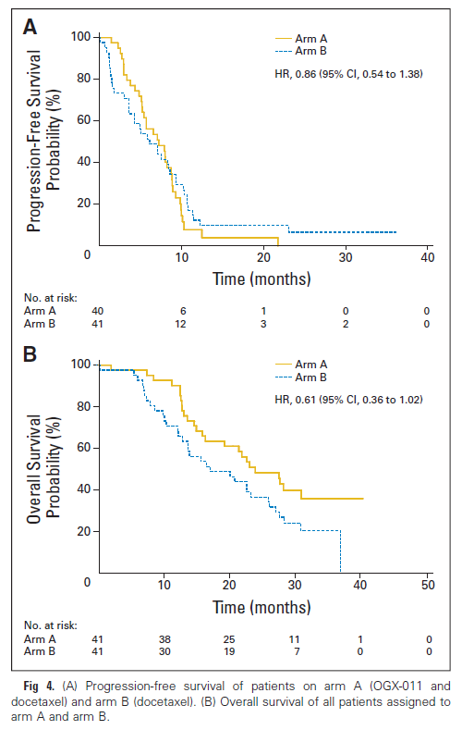
IND.165 Exploratory Results

Slide 39
IND.165 Conclusions
Docetaxel/ prednisone plus OGX 011:
Well tolerated
  Predefined protocol criteria for further study met but similar rates of PSA decline and RR in both arms
  Evidence of biological effect with decreases in serum clusterin
  Trends in PFS and OS are of clinical interest
  Exploratory analyses of OS strongly suggest clinical benefit (HR 0.50 95%CI 0.29-0.87)

Slide 40
IND.165
Randomized Phase II Trial
    Concurrent control included to anchor interpretation of experimental arm
    Experimental arm: H0, HA, error rates predetermined as in a single arm phase II
  Subsequent phase III trials failed to demonstrate efficacy

Slide 41
Randomized Phase II Trial Design:
Multiple Experimental Arms (Selection Design)

Slide 42
Selection Design
Simultaneous evaluation of multiple experimental regimens
Prioritization for further evaluation based on antitumour activity, safety, tolerability, compliance

Slide 43
IND.163
Ellard et al J Clin Oncol 2009
EVEROLIMUS
in Breast Cancer

Slide 44
Rationale
Breast Cancer
  Common, incurable in the advanced disease setting
  mTOR (mammalian target of rapamycin)
  Involved in cell replication
  Mediates the critical PI3K/AKT pathway which is active in breast cancer
  Other functions: mediates VEGF, PDGF and TGF
  Preclinical inhibitor of mTOR inhibits proliferation
  Other mTOR inhibitors active against solid tumours (temsirolimus renal cell carcinoma)

Slide 45
Everolimus in Breast Cancer
  Everolimus
  Orally bioavailable
  Uncertainty about optimal dosing schedule: weekly versus daily

Slide 46
IND.163
Recurrent/ metastatic breast cancer
Strat factors:
Visceral metastases
Prior chemo regimens
R A N DOM I Z E
Everolimus
10 mg po daily
for 28 days q4 weeks
RR and early progression*
Everolimus
70 mg po once weekly (day 1, 8, 15, 22)
q4 weeks
N < 30 each arm
* Zee B, et al. J Biopharm Stat 1999

Slide 47
IND.163 Objectives
Primary
To evaluate in parallel fashion in each arm:
    Anti tumour efficacy based on RR and early PD
Secondary
To evaluate in parallel fashion in each arm:
    Adverse event, time to progression and response duration
    To correlate RR with molecular markers of mTOR activity
    To correlate RR with molecular markers of mTOR activity in fresh tumour samples (consenting patients)

Slide 48
IND.163
Statistical Parameters
No formal comparison between the two arms
  H0 response = 0.05 H0 early progression = 0.60
  HA response =0.20 HA early progression = 0.40
First stage, enter 15 patients each arm
  If 0 responses AND 10 or more early progressions, stop entry into that arm.
  If 1 or more responses OR < 10 early progressions, continue that arm and enter 15 more patients.

Slide 49
IND.163
Statistical Parameters
After 30 patients total per arm
  If 4 or more responses OR if 13 or fewer early progressions, accept drug as worth further study
Corresponds to type 1 error = 10% power = 93%

Slide 50
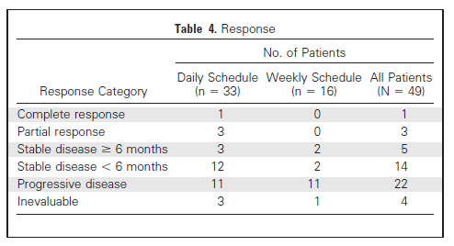
IND.163 Results
Daily Schedule: 4 responses (12%; 95% CI, 3.4% to 28.2%)
Weekly Schedule: 0 responses; 11 early progressions end of stage 1

Slide 51
IND.163 Conclusions
Daily dosing of everolimus in minimally pretreated breast cancer patients is active based on predefined study criteria
Data support further testing
Unable to demonstrate any statistical association between response and biomarkers
Subsequent phase III trials demonstrated efficacy of daily dosing schedule

Slide 52
Randomized Phase II Trial Design:
Experimental Arm Compared to Standard of Care (Screening Design)

Slide 53
Screening Design
Non definitive comparison of one or more experimental regimes against the standard of care treatment
Uses an intermediate endpoint such as RR or PFS
Suggested error Type I (false positive ) and Type 2 (false negative) error rates of 0.20 for both and a target difference of 20% (or hazard ratio of 1.5)
Not a substitute for a randomized phase III trial

Slide 54
IND.209
EIGL et al, oncotarget 2018
Pelareorep (Reolysin) and Docetaxel in Metastatic Castration Resistant Prostate Cancer

Slide 55
Rationale
Castration Resistant Prostate Cancer
Second leading cause of cancer death in men
Docetaxel effective but has modest benefit
Pelareorep
  Preferentially infect and exhibit cytotoxic effects in human cancer cells
  May potentiate anti tumour immune responses
  Preclinical data demonstrated activity against prostate cancer cell lines and xenografts
  Synergism with taxanes
  Phase I trial in combination with docetaxel showed activity and tolerability

Slide 56
IND.209
Metastatic
Castration
Resistant
Prostate Cancer
R A N DOM I Z E
Arm A
Docetaxel 75 mg IV d1
Prednisone 5 mg po bid
Pelareorep 3×10¹⁰ TCID₅₀IV d1-5
Progression Status at 12 weeks
Arm B
Docetaxel 75 mg IV d1
Prednisone 5 mg po bid
N = 80

Slide 57
IND.209 Endpoints
Primary
Lack of Progressive Disease (LPD) at 12 weeks
Secondary
Objective Response Rate
PSA change rate
Overall Survival
CTC counts
Prognostic/predictive biomarkers

Slide 58
IND.209 Statistical Parameters
  40 patients treated by pelareorep plus docetaxel and prednisone:
    H0 12 week Lack of PD (LPD) rate < 30% vs HA 12 week LPD rate > 50%
With a total sample size of 80
    90% power to detect difference between arms in 12 week LPD rate from 20 to 50% with two-sided alpha 0.1
    58% power to detect a difference between arms in 12-week LPD rate from 30 to 50% with two-sided alpha 0.1

Slide 59
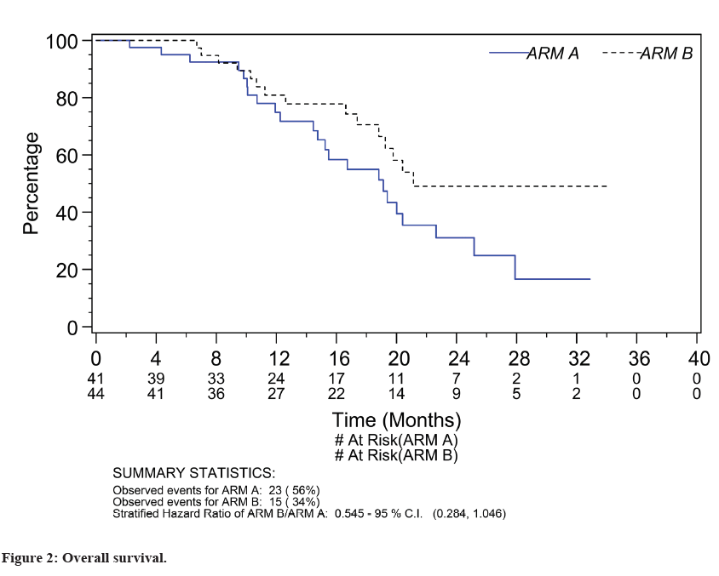
IND.209 Study Results
12-week LPD rate was 61% (Arm A experimental) and 52.4% (Arm B control) p=0.51
Response rates: 26.7% (Arm A) and 40% (Arm B); adjusted OR 0.53; 95% CI 0.12 to 2.38, p=0.41
Overall survival: HR 1.83 (95%CI 0.96-3.52, p=0.06) (no benefit)

Slide 60
IND.209 Conclusion
Combination of pelareorep with docetaxel was tolerable with comparable LPD in both arms but response and survival were inferior and so this combination does not merit further study

Slide 61
Can we improve the efficiency of the randomized, comparative phase II (Screening) design

Slide 62
Randomized Phase II/III Trial Design

Slide 63
Br.18
Douillard et al, LUNG CAn 2004 leighl et al, J Clin Oncol 2005
A PHASE II/III DOUBLE BLIND RANDOMIZED TRIAL OF BMS-27529l VS. PLACEBO IN PATIENTS RECEIVING PACLITAXEL/CARBOPLATIN CHEMOTHERAPY FOR THE TREATMENT OF ADVANCED OR METASTATIC NON-SMALL CELL LUNG CANCER

Slide 64
Rationale
Advanced/ metastatic non small cell lung cancer
  Leading cause of cancer death in men
Platinum based chemotherapy – a treatment option
BMS 275271
  Orally bioavailable inhibitor of matrix metalloproteinases which appear to be important in tumour growth and spread
  Preclinical data demonstrated antiproliferative activity in several animal models
  May improve outcomes when combined with chemotherapy

Slide 65
BR.18
Stage IIIB/IV NSCLC
Strat factors:
Stage IIIB vs IV
ECOG 0,1 vs 2
R A N DOM I Z E
Arm A
BMS275271 daily
+
paclitaxel/carboplatin q21 days
Survival
Arm B
Placebo
+
paclitaxel/carboplatin q21 days

Slide 66
BR.18 Phase II Trial Objectives
To evaluate the incidence of grade 2 or higher drug related arthritis, arthralgia and/or myalgia in each arm
To estimate the objective tumour response rate in each arm
To evaluate the nature, severity, and frequency of toxicities

Slide 67
BR.18 Phase III Trial Objectives
Primary
To compare overall survival (OS) between the 2 arms
Secondary
Progression-Free Survival
Response Rates/ Time to Response, Response Duration
Toxicities
Quality of Life/ Economics
Biological Correlatives – correlation of tissue MMP, circulating MMPs with outcomes

Slide 68
BR.18 Trial Statistical Parameters
Phase II
With a total sample size of 30 each arm
    Ha > 20%: > 2 responses in the experimental arm
  AND
    incidence of grade 2 or greater drug related arthritis, arthralgia and/or myalgia, a lower limit of the 95% confidence interval less than 50%

Slide 69
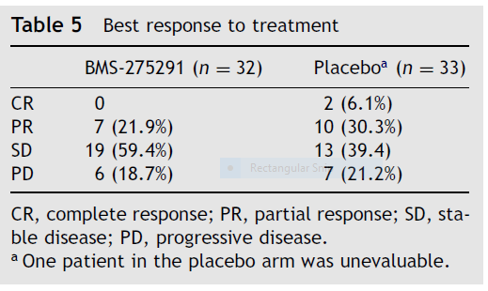
BR.18 Trial Phase II Results
Toxicity
  Grade > 2 drug related toxicities of interest
    BMS-275291: 31.5%, lower limit 95% CI = 17.6%
  Response Rates

Slide 70
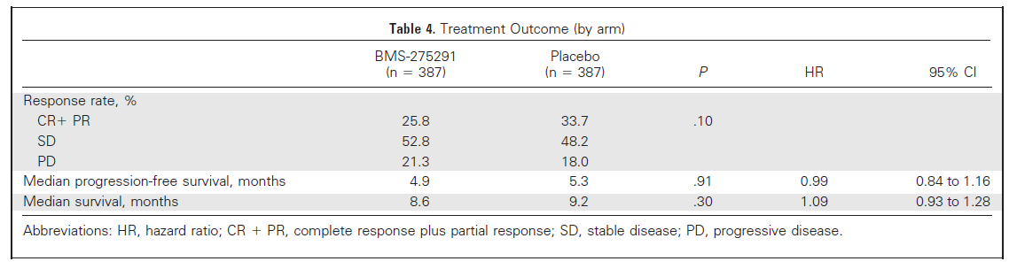
BR.18 Trial Phase III Efficacy Results
HR 1.09 (0.93-1.28) P=0.30

Slide 71
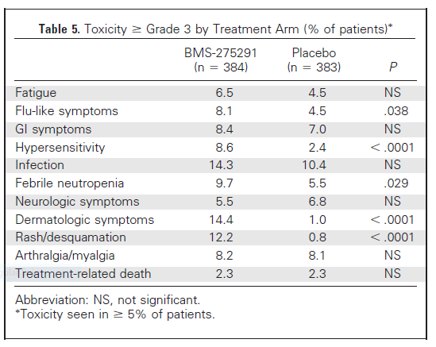
BR.18 Trial Phase III Results: Toxicity

Slide 72
BR.18 Trial Conclusion
BMS 275291 does not add to the treatment of advanced NSCLC.

Slide 73
Variations of Phase II Trial Methodology: Platform Trials (more to come!)

Slide 74
Learning Objectives
√ To define the role of a phase II trial in oncology drug development
√To describe the objectives and the statistical parameters that provide the framework of a phase II trial design

Slide 75
Thank You

Slide 76
References
Buckstein R et al. Leukemia & Lymphoma, 2011; 52(5): 833–41
Chi KN et al. J Clin Oncol. 2010; 28(27): 4247-54
Chi KN et al. Lancet Oncol. 2017; 18: 473-85
Beer TM et al. Lancet Oncol. 2017; 18(11): 1532-42
Ellard SL et al. J Clin Oncol. 2009; 27(27): 4536-41
Baselga J et al. N Engl J Med. 2012; 366: 520-9
Zee B et al. J Biopharm Stat. 1999; 9(2):351-63
Eigl BJ et al. Oncotarget 2018;9(8):8155-64
Douillard et al. Lung Cancer 2004;46(3):361-8
Leighl NB et al. J Clin Oncol. 2005;23(12):2831-39
Review articles
Rubinstein L et al. Clin Cancer Res. 2009;15(6): 1883-90
Mandrekar S et al. J Thorac Oncol. 2010;5: 932–934
Seymour L et al. Clin Cancer Res. 2010; 16(6): 1764-9

